Slide 1
Dbatools for the Uninitiated
Notes:
How many use PowerShell?
Used sqlps, sqlserver or dbatools modules?
How many instances do you manage?
Any scripting?
Ever automated daily tasks?

Slide 2

Who am I?
Web Developer/Web Server Admin
Systems Integrator
Development DBA
Production DBA
dbatools Contributor
User Group Leader
SQL Saturday Organizer
Notes:
Since 1999
Visit & thank sponsors & volunteers

Slide 3
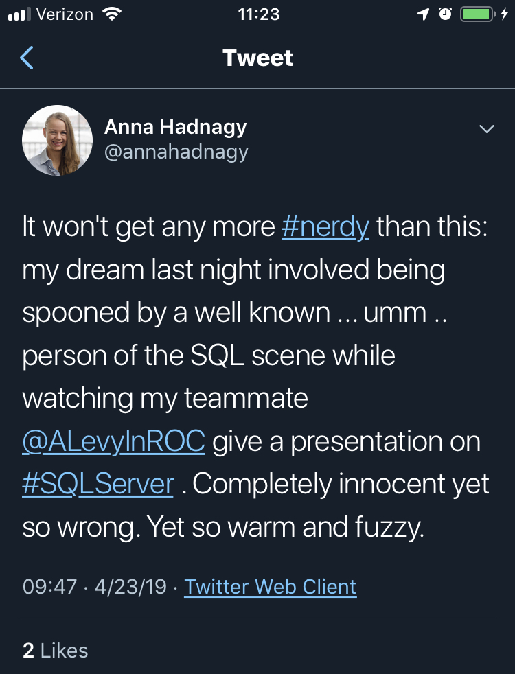
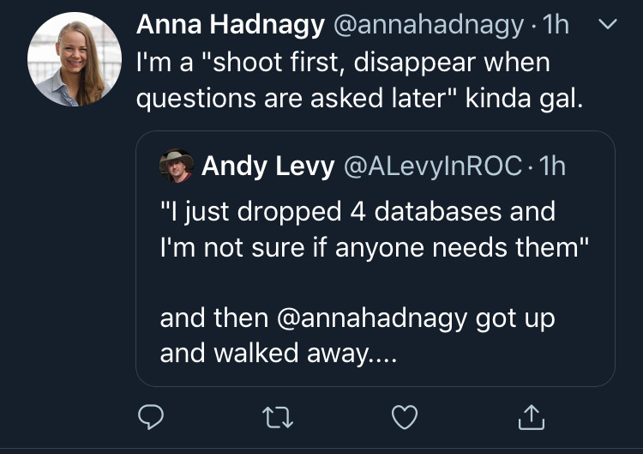
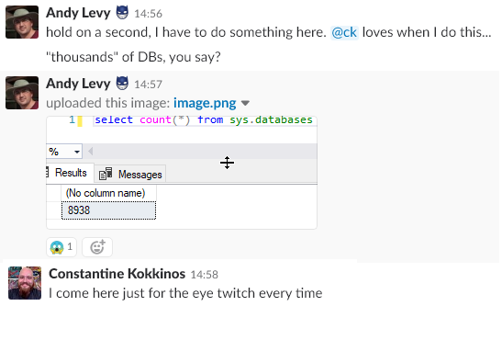
Who Am I?
Notes:
8K DBs - design problems get magnified at scale
She said I could!

Slide 4
Why Automate?
Documentation
Scripting is communication
Repeatable
Trackable
Scalable
Notes:
Documentation - better than Word
Trackable - “You can’t put clicks in source control”

Slide 5
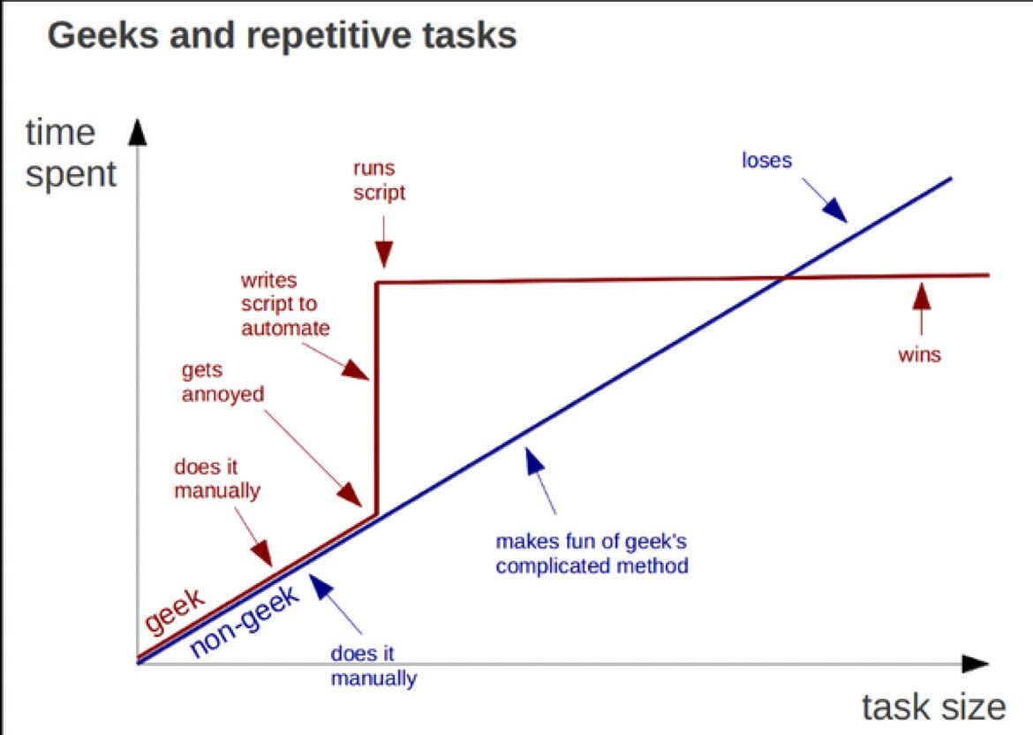
https://twitter.com/kirkdborne/status/804145411997007873

Slide 6
Microsoft & Automation
Ancient History - Batch/cmd files
The Middle Ages - Windows Scripting Host
The Renaissance (2006) - PowerShell 1.0
The Enlightenment (2016) - PowerShell Core
Notes:
Jeffrey Snover is now a Microsoft Technical Fellow

Slide 7
Discovery
Get-Command/Find-DbaCommand
Get-Help
Get-Member
Notes:
TODO: Show Find-DbaCommand “Connect”

Slide 8
SQL Server & PowerShell
2008 - sqlps & PowerShell Agent Job Step
2016 - sqlserver
2017 - sqlserver in Powershell Gallery
Good starting point
Notes:
Module and cut-down version of PowerShell. Don’t use any of these
Released with SSMS 2016, then sat idle
Moved to gallery April 2017
See Drew’s session for more detail

Slide 9
What is dbatools?
Open Source Powershell module for data professionals
BDFL Chrissy LeMaire
163 contributors
Started July 2014
1.0 on June 20, 2019
Notes:
Single purpose - now almost 550 functions

Slide 10


dbatools vs. sqlserver
Mega multitool vs. Swiss Army Knife
Breadth & depth
Release frequency
Community-driven

Slide 11
Contributing
Issues
Feature Requests
Documentation
Slack!
Code!

Slide 12
wrap-up

Slide 13





Where to Find Me
https://flxsql.com/
andy@flxsql.com
@alevyinroc

Slide 14
SMO

Slide 15
Backup and Restore
Install Ola solution
Restore to point in time
Snapshots

Slide 16
Instance Migrations
Copy/update configuration
Copy security
Copy Agent jobs
Copy data

Slide 17
Monitoring
First responder kit
Whoisactive
Glenn berry queries
Watch-*

Slide 18
Maintenance
Ola hallengren
Compression

Slide 19
Validation
Test last backup

Slide 20
Automation
Migration
Copy databases
Configuration

